Slide 1

RUNGTA COLLEGE OF DENTAL SCIENCES & RESEARCH
TITLE OF THE TOPIC-MATRICES AND WEDGES
DEPARTMENT OF CONSERVATIVE DENTISTRY AND ENDODONTICS

Slide 2
Specific learning Objectives
At the end of this presentation the learner is expected to know ;
Core areas* | Domain ** | Category #
Wedge methods | COGNITIVE | MUST KNOW
matrices | PSYCHOMOTOR | NICE TO KNOW
Recent advances | AFFECTIVE | DESIRE TO KNOW

Slide 3
    CONTENT
    Wedge method
    Classification of wedges
    Functions of wedges
    Wedging techniques
    Error’s with wedge placement
    Test for proper wedge placement
    Elliots separator
    Traction method
    Non-Interfering true separator
    Ferrier double-bow separator
3

Slide 4
Slow/ Delayed tooth movement
Methods:
Separating wires
Oversized temporaries
Orthodontic appliances
Matricing
  Classification of matrices
  Matrix Band and retainer
  Qualities of a good matrix
  Universal Matrix (Tofflemire matrix)
  Ivory Matrix No.1
  Ivory Matrix No. 8
  Black’s matrices
  Copper Band Matrix / Soldered Band

Slide 5
Anatomical Matrix
Roll in band matrix ( Automatrix)
S-shaped Matrix Band
T-shaped matrix
Mylar Strips
Aluminium Foil Incisal Corner Matrix
Transparent Crown Form Matrix
Window Matrix
Preformed Transparent Cervical Matrix
Recent Advances
Contact Forming Instruments
Contact Rings
First generation systems
Second - Generation Rings
Metafix Matrix System
Bioclear Matrix system
Fender Wedges
Slick Bands
Conclusion
References
Notes:
Palodent Bitine
Contact matrix
Composi-Tight
Composi-Tight 3D soft face ring system
V3 ring system

Slide 6

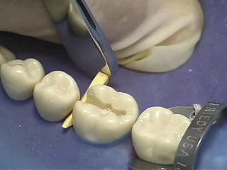
Methods
1. Wedge method
By insertion of a pointed wedge shaped device between the teeth
The more the wedge moves facially or lingually, greater is the separation.
6

Slide 7
Wedges
Classification
Wedges
Natural synthetic Medicated
Non medicated Performed Round
Wood Plastic
Custom made
Triangular
Wedges are used interdentally to ensure close adaptation of the matrix band with the gingival seat of prepared proximal cavity.
Notes:
Medicated with astringent to control bleeding

Slide 8

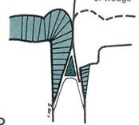
Wood/ Plastic Wedges
Used in both tooth separation for preparation and restoration
Triangular shaped wedges (wood/synthetic resin)
Cross-section base of triangle will be in contact with interdental papillae.
Two sides of the triangle should coincide with the corresponding 2 sides of the gingival embrasure.
Apex must coincide with the gingival start of the contact area.
8

Slide 9
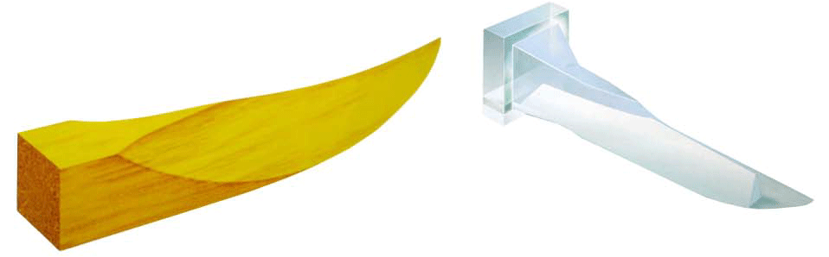
Functions:
Hold the matrix band in position
Slight separation of the tooth
Provides space for placing matrix band
Prevent gingival overhang
Stabilizes matrix and retainer
Assure close adaptability of matrix band to the tooth
Protect interproximal gingiva from unexpected trauma
9

Slide 10
Types:
  Wooden
  Plastic
  Elastic
  Transparent
  Medicated wedges
Shape:
  Triangular
  Round
  Trapezoidal
10

Slide 11
Wedging method:
Location : Gingival embrasure just beneath the contact area.
Selection
: Depending upon the clinical situation.
: Wooden wedges can be trimmed using a knife or scalpel blade to produce a custom fit.
Placement : From the lingual embrasure which is normally larger in size.
: But if it interferes with the tongue it may be placed from the buccal side.
Length
: ½” or 1.3cm so that it does not irritate the tongue or the cheek.
After placement the wedge should be firm and stable.

Slide 12

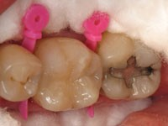

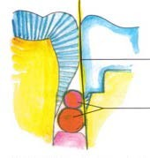
Wedging techniques
Single wedge technique
  Single wedge is placed in the gingival embrasure
Piggyback wedging
  A second wedge is placed on top of the first wedge to wedge adequately the matrix against the margin
  Indicated for patients whose interproximal tissue level has receded.
41

Slide 13

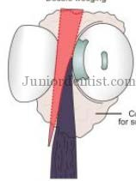
Double wedging technique
  Here, 2 wedges, one from the facial embrasure and the other from the lingual embrasure are used.
  Used when proximal box is wide faciolingually.
  Should be used only if the middle 2/3rd of the proximal margins can be adequately wedged.

Slide 14

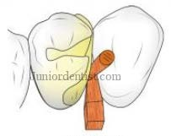
Wedge wedging technique
  Used in cases when there is a gingival concavity as in the case of a fluted root.
  Inorder to wedge a matrix band tightly against such a margin, a second wedge is inserted between the first wedge and the band.

Slide 15

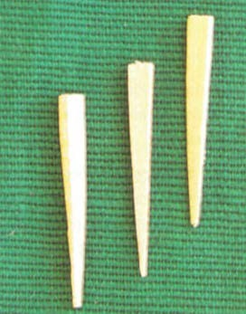
Rounded toothpick wedge is usually the wedge of choice with conservative premolar boxes.
Triangular wooden wedges are more recommended since:
  Easy to trim and adapt well to tooth surface
  When properly shaped, they remain stable during condensation
  Absorb moisture and swell to provide adequate stabilisation
  Wooden wedges can be cut from toothpicks

Slide 16


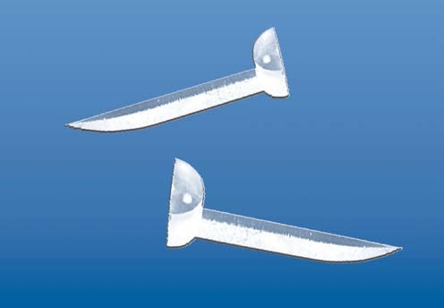
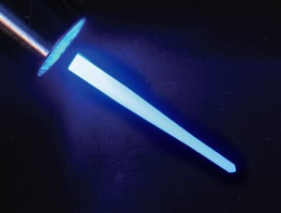
Light Transmitting Wedges
Plastic wedges which are transparent and have a light reflecting core.
Used with transparent matrices
Can transmit 90 – 95% of the incident light : drawing the curing light to the gingival margins of the restoration
Provides better marginal adaptation at the cervical area of the class II composite resin restorations
Notes:
Pigment suspended in gelatin method

Slide 17

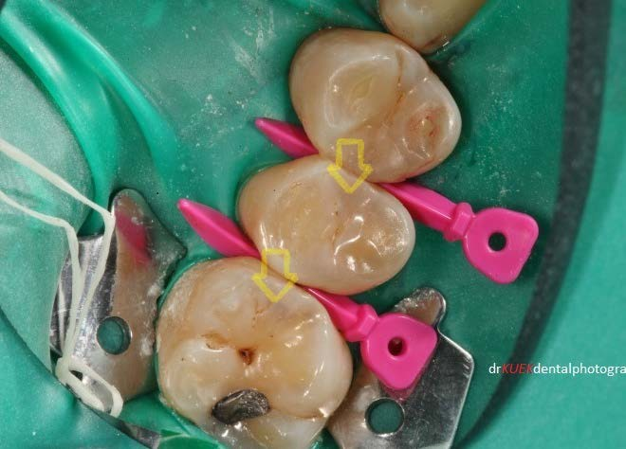
Prewedging
The procedure of inserting a wedge between the interproximal surfaces of two adjacent teeth prior to cutting a cavity involving a proximal wall.
Purpose is to achieve some tooth separation such that, after restoration, the teeth will return to their original position and a more positive tooth contact area will be achieved.

Slide 18
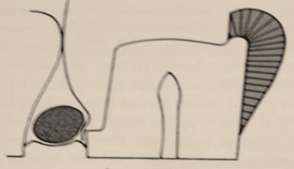

Error’s with wedge placement
If wedge is placed more occlusal to the gingival margin, creates abnormal concavity in the proximal surface of the restoration.
If wedge is far apical to gingival margin, band will not be held tightly against the gingival margin & creates gingival overhangs in the restorations.

Slide 19
Test for proper wedge placement
1. Explorer test
Used to test for tightness of the wedge at several points along the middle 2/3rd of the gingival margin (against the matrix band), to verify that it cannot be moved away from the gingival margin.
Testing with explorer in a press scrape motion for soundness of enamel margin and matrix tightness.
2. Displacing test
Attempts to remove the wedge (using explorer with moderate pressure) after first having set the explorer tip into the wood near the broken end.
Moderate pulling should not cause dislodgment

Slide 20
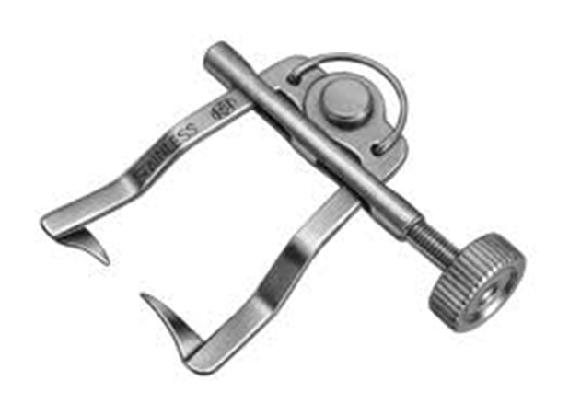
Elliots separator
Indicated for short duration separation that does not necessitate stabilization
Useful in examining proximal surfaces in final polishing of restored contacts.
20

Slide 21
Indications
For short duration separation that does not necessisate stabilization
Useful in examining proximal surfaces or in final polishing of restored contacts.
Types
This separator is available with straight or curved types.
Anterior and posterior types are also available.
Procedures
Adjust the two opposing wedges of the separator interproximally gingival to the contact area.
Move the knob clockwise so that the wedges moves towards each other.
Desired separation
The tightening screw can be removed and inserted from the other end if one chooses to separate teeth on the right side of the arch.
Softened compound is placed on the teeth below the separator and on the occlusal surface to give additional stability.

Slide 22
2. Traction method
Done with mechanical devices which engage the proximal surfaces of the teeth to be separated by means of holding arms.
  Non-Interfering true separator
  Ferrier double-bow separator

Slide 23

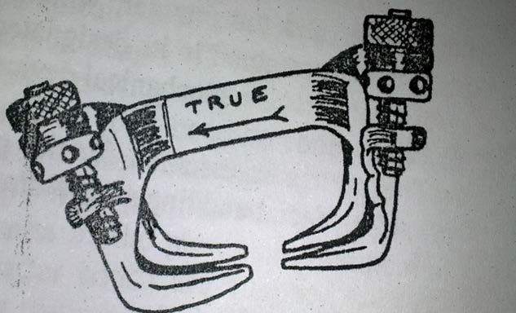
Non-Interfering true separator
Indicated when continuous stabilized separation is required.
Advantage:
  Separation can be increased or decreased after stabilization
  Device is non-interfering

Slide 24

Procedure:
Apply the jaws closest to the bow against the tooth to be operated upon.
Apply a piece of softened compound to teeth under separator.
A wrench used to move the jaws over the approximating tooth.
The Nut on the facial side moved first until the jaw touches the surface needed, then that of lingual side.
Repeat the adjustment until desired amount obtained.

Slide 25

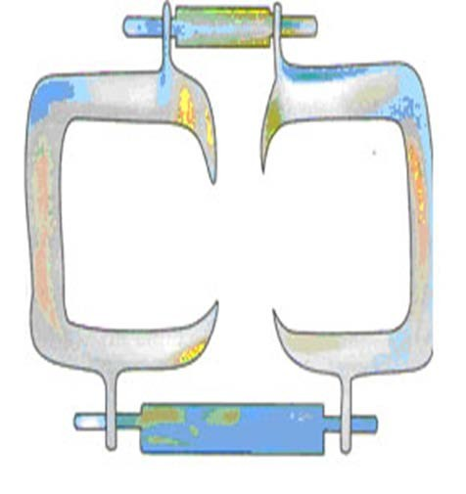
Ferrier double-bow separator
Separation is stabilized throughout the dental operation.
Advantage :
  Separation is shared by the contacting teeth and not at the expense of one tooth

Slide 26

Procedure:
Four arms are adjusted so each will hold a corner of proximal surface of contacting teeth.
Arms will be gingival to contact area.
Wrench applied to labial and lingual to make desired separation.

Slide 27
Slow/ Delayed tooth movement
Indications:
When teeth have drifted and/or tilted considerably, rapid movement of the teeth to proper position will endanger the periodontal ligaments.
Therefore slow tooth movement over weeks will allow proper repositioning of teeth in physiological manner.
Methods:
Separating wires
Oversized temporaries
Orthodontic appliances

Slide 28
Separating wires
Thin pieces of wire are introduced into the gingival contact area
It is then wrapped around the contact area.
The 2 ends are then twisted together to create separation not to exceed 0.5mm
Wires are tightened periodically to increase the separation.

Slide 29
Oversized temporaries
Resin temporaries are oversized mesio-distally to achieve slow separation
Resin added periodically to increase the amount of separation not to exceed 0.5mm

Slide 30
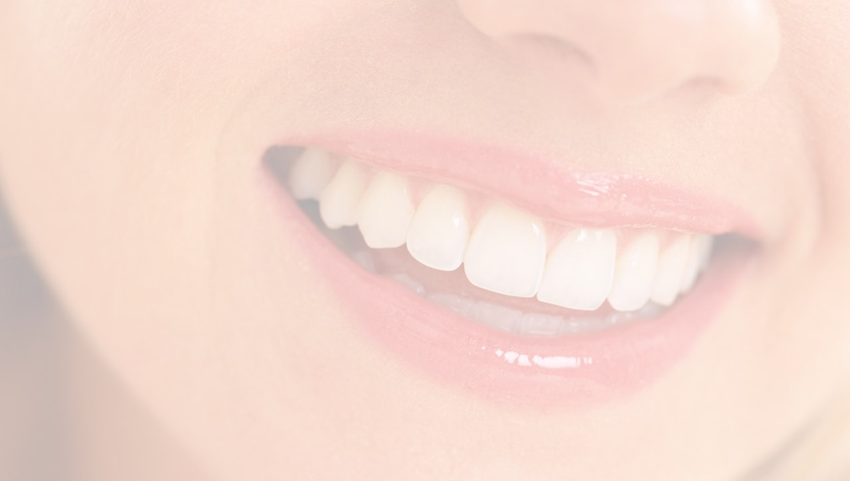
Conclusion
Proper restoration of the anatomical landmarks is important for enhancing the longevity of restorations as well as to maintain the occlusal health and harmony.
Matricing is a vital step during the placement of different restorations.
Selection of the matrix should be based on its ease of use and efficiency to provide the optimum contacts and contours..
The dentist should select the right method according to the needs of individual case.
30

Slide 31
References
Operative Dentistry – MA Marzouk
Art & science of operative Dentistry – Sturdevants (5th edition)
Art & Science of Operative Dentistry – Sturdevants (South Asian Edition)
Textbook Of Operative Dentistry – Vimal K Sikri (1st Edition)
Dental Anatomy, Physiology & Occlusion – Wheeler’s (9th Edition)
Optimizing tooth form with direct posterior composite restorations JCD Oct-Dec 2011 | Vol 14 | Issue 4
31

Slide 32
Matrix band and wedges are commonly used to prevent overhanging margins at the proximal area .
The applied wedge seals the cavity interface , creates minor tooth separation to compensate for the thickness of the matrix band , affects the proximal contour.
TAKE HOME MASSEGE

Slide 33
1) Classification of wedges ?
2) Functions of wedges ?
3) What is elliots separator ?
QUESTIONS

Slide 34
References
Endodontics - IngleOperative Dentistry – modern theory and practice - M.A.Marzouk
Art and Science of operative dentistry. Seventh Edition – Sturdevant’s
Clinical operative Dentistry Principles and Practice . Second edition –Ramya Raghu
Author : I . A. Ahmad. Rubber dam usage for endodontic treatment : a review. International Endodontic journal 2009;42:963-972.
Author: Nidambur vasudev ballal, Deepika khandelwal and muliya vidya saraswathi . Rubber dam in endodontics- An overview of recent advances. International Journal of Clinical Dentistry.2018;6(4)320-30.

Slide 35



117

